Slide 1
DOOR LOCK SYSTEM USING ARDUINO
SE(SEM-4)Mini project, a.y.(2020-21)

Slide 2
GROUP MEMBERS
1.ARSHAD ABBAS KHAN
2.KHAN SAKIB QAMRUDDIN
3. MOHAMED HAMMAD
4.KASIM PATEL
5. Mohammed HAARIS SHAIKH

Slide 3
INTRODUCTION
- Security is a main concern in everyday life as ever individual wants to feel secure
- Door locked using conventional locks are not as safe as they used to be as anyone can break in
- There are so many types of security systems present today but behind the scene, for authentication they all relay on fingerprint, retina scan etc
- Password based door lock systems allows only approved persons to access restricted areas.
- Off all the solutions the Arduino Keypad Door Lock which is controlled by Arduio can be mounted to any of your existing doors to secure them with a digital password.

Slide 4
CONSTRUCTION
To design Arduino keypad door lock we start from the Arduino UNO board, which is connected to a16 x 2 LCD which displays the message by Arduino.
We can use a 5v Towerpro SG90 servo motor for making our customized door locker.
It is a basic level servo motor and works fine with Arduino without any driving circuit or external module.
We need a keypad for password input and manually lock our customized door locker which consists of 16 keys.
Finally it has a positional micro servo(latch)

Slide 5
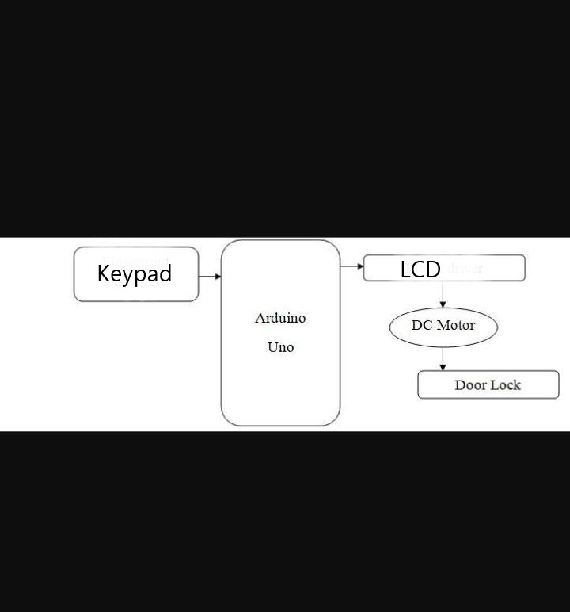
BLOCK DIAGRAM
BLOCK DIAGRAM OF DOOR LOCK SYSTEM USING ARDUINO

Slide 6
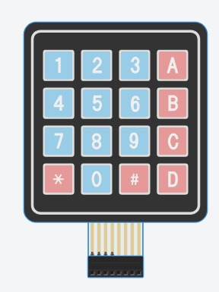
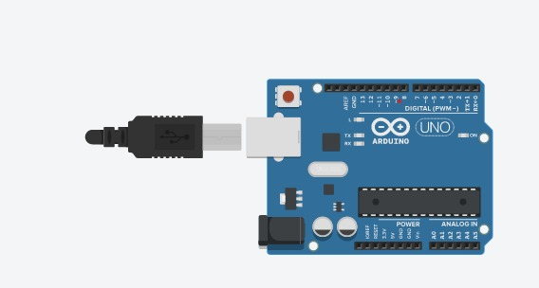

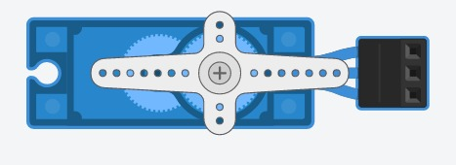
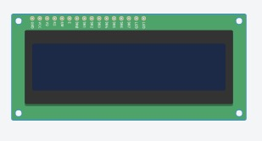
LIST OF COMPONENTS
Arduino uno r3
LCD 16*2
1k ohm Resistor
220 ohm Resistor
Keypad 4*4
6.Positional Micro Servo
Software
Tinker cad online website
https://www.tinkercad.com/

Slide 7
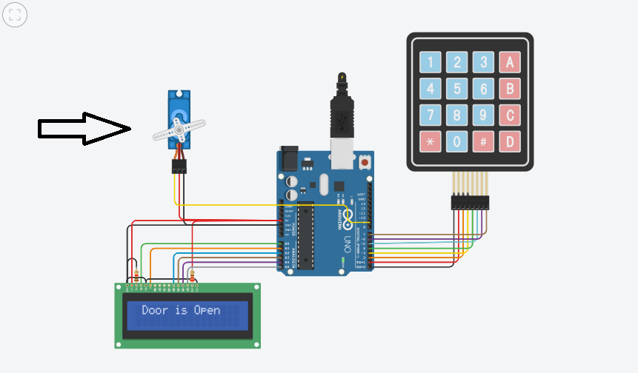
CIRCUIT DIAGRAM
CIRCUIT DIAGRAM OF DOOR OCK SYSTEM

Slide 8
APPLICATIONS
- Password based door lock system is used widely in places where we need to secure something
They are used in Banks and in place where some valuable information has to be secured
They can also be used in place of normal door locks as they are more secure & reliable
They can even be used in places where there is a need of securing like a locker or cupboard

Slide 9
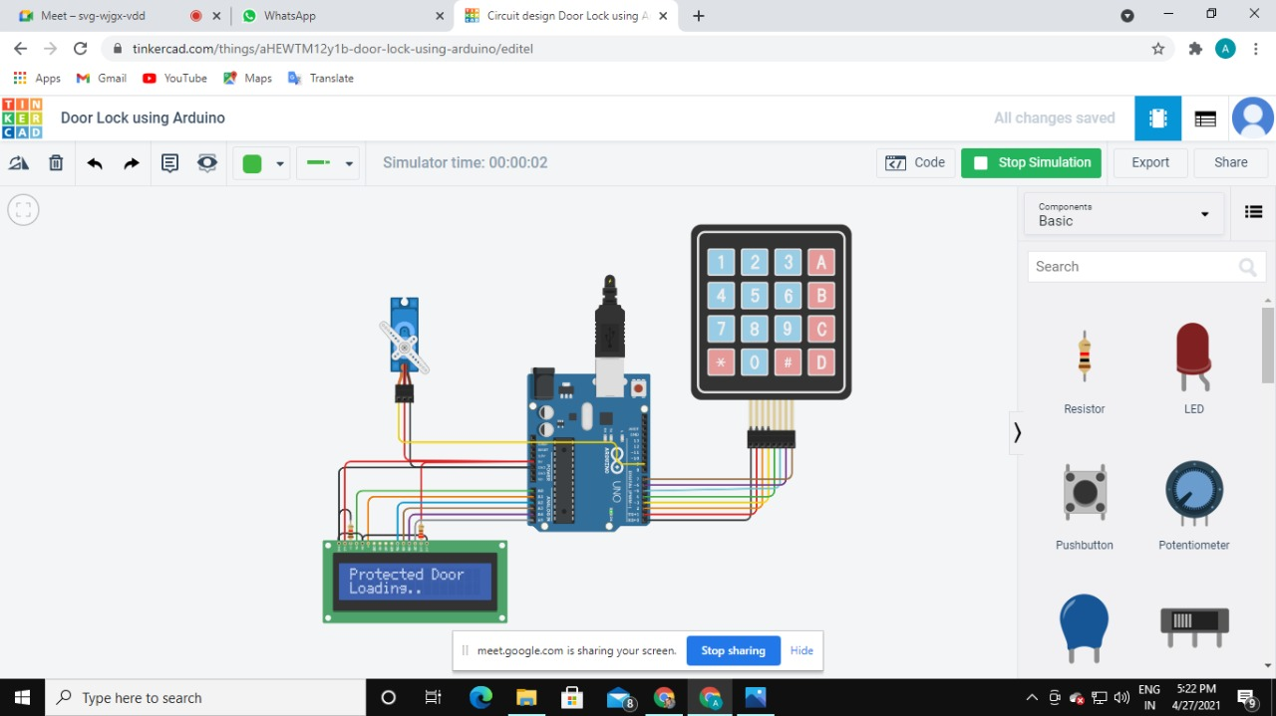
RESULT(SIMULATION)
CASE 1: Setup of door lock system using arduino
logicly.com

Slide 10
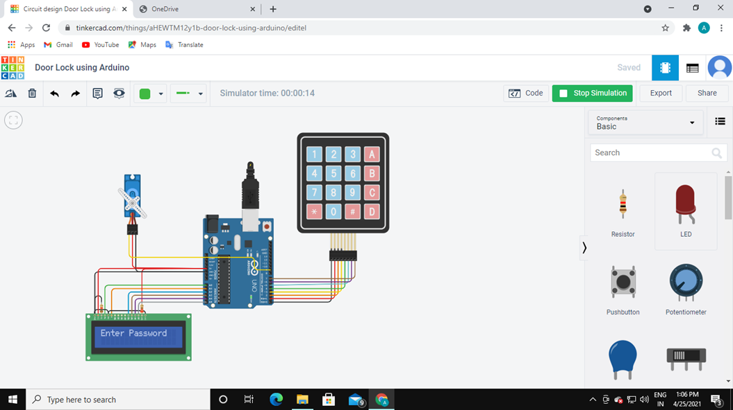
CASE 2:Working of door lock system when enter password is shown after setup

Slide 11

case 3:Working of Door lock system after the password is entered

Slide 12
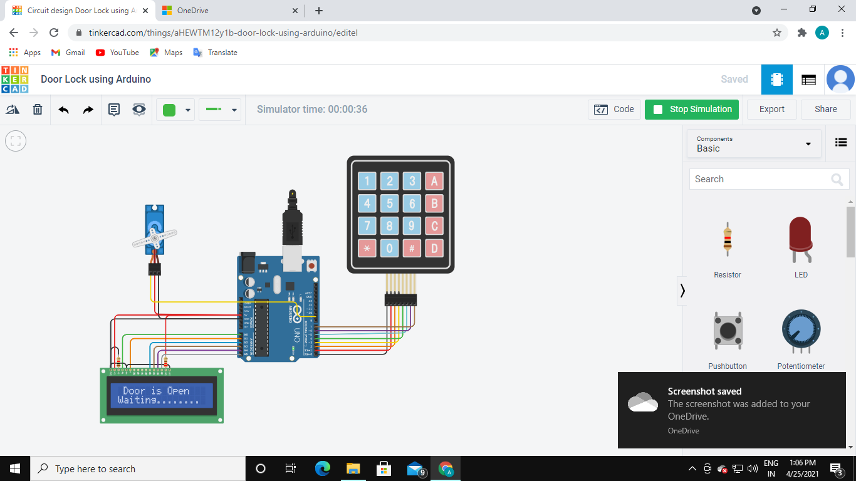
CASE4:When the door is waiting for action after after entering the password

Slide 13

CASE5:Working of Door lock system when wrong password is entered

Slide 14
- THANK YOU

